Slide 1


International University
MICRO-PROCESSING SYSTEM
Lecture 9A:
AVR Timer Programming in C
Vo Minh Thanh, M.Eng
School Of Electrical Engineering

Slide 2
Counter mode and Timer mode
There are counter registers in microcontrollers to count an event or generate time delays.
When we connect the external event source to the clock pin of the counter register. This is counter mode.
When we connect the oscillator to the clock pin of the counter. This is timer mode
one way to generate a time delay is to clear the counter at the start time and wait until the counter reaches a certain number.

Slide 3
Counter mode and Timer mode
In the microcontrollers, there is a flag for each of the counters. The flag is set when the counter overflows, and is cleared by software.
The second method to generate a time delay is to load the counter register and wait until the counter overflows and the flag is set.
In ATmega32,ATmega16, there are three timers: Timer0, Timer1, and Timer2. TimerO and Timer2 are 8-bit, while Timer1 is 16-bit.
In AVR, for each of the timers, there is a TCNTn (timer/counter) register. In ATmega32 we have TCNTO, TCNT1, and TCNT2.
The TCNTn register is a counter. Upon reset, the TCNTn contains zero. It counts up with each pulse. The contents of the timers/ counters can be accessed using the TCNTn. You can load/read a value into the TCNTn register

Slide 4
Basic Registers of Timers
Each timer has a TOVn
(Timer Overflow) flag, When a timer overflows, its TOVn flag is set.
Each timer also has the TCCRn (timer/counter control register) register for setting modes(timer or counter) of operation.
Each timer also has an OCRn (Output Compare Register). The content of the OCRn is compared with the content of the TCNTn. When they are equal the OCFn (Output Compare Flag) flag is set.

Slide 5
Timer0 Programming
Timer0 is 8-bit in ATmega32; thus, TCNT0 (timer/ counter register) is 8-bit.
TCCRO (Timer/Counter Control Register) register is an 8-bit register used for control of Timer0.
CS02:CS00 (Timer0 clock source)
These bits in the TCCRO register are used to choose the clock source. If CS02:CS00 = 000, then the counter is stopped. If CS02:CS00 have values between 001 and 101, the oscillator is used as clock source and the timer/counter acts as a timer. In this case, the timers are often used for time delay generation. If CS02:CS00 are 110 or 111, the external clock source is used and it acts as a counter

Slide 6
Bit |  | D7 |  | D6 |  |  | D5 |  | D4 |  | D3 | D2 |  | D1 | D0
 |  | FOC0 |  | WGM00 |  |  | COM01 |  | COM00 |  | WGM01 | CS02 |  | CS01 | CS00
Read/Write |  | W |  | RW |  |  | RW |  | RW |  | RW | RW |  | RW | RW
Initial value |  | 0 |  | 0 |  |  | 0 |  | 0 |  | 0 | 0 |  | 0 | 0
FOC0 | D7 | Force compare match: this is a write-only bit, which can be used while generating a wave. Writing 1 to it causes the wave generator to act as if a compare match had occurred.
WGM00, WGM01 |  |  | D6 |  | D3 |  |  | Timer0 mode selector bits
 |  |  | 0 |  | 0 |  |  | Normal
 |  |  | 0 |  | 1 |  |  | CTC (Clear Timer on Compare Match)
 |  |  | 1 |  | 0 |  |  | PWM, Phase Correct
 |  |  | 1 |  | 1 |  |  | Fast PWM
COM01 COM00 |  |  | D5 |  | D4 |  |  | Compare Output Mode:
 |  |  |  |  |  |  |  | These bits control the waveform generator (See chapter 15)
CS02 CS01 CS00 |  |  | D2 |  | D1 |  |  | D0 |  | Timer0 Clock Selector
 |  |  | 0 |  | 0 |  |  | 0 |  | No clock source (Timer/Counter stopped)
 |  |  | 0 |  | 0 |  |  | 1 |  | CLK (No Pre-scaling)
 |  |  | 0 |  | 1 |  |  | 0 |  | CLK / 8
 |  |  | 0 |  | 1 |  |  | 1 |  | CLK / 64
 |  |  | 1 |  | 0 |  |  | 0 |  | CLK / 256
 |  |  | 1 |  | 0 |  |  | 1 |  | CLK / 1024
 |  |  | 1 |  | 1 |  |  | 0 |  | External clock source on T0 pin. Clock on falling edge
 |  |  | 1 |  | 1 |  |  | 1 |  | External clock source on T0 pin. Clock on rising edge
Figure 9-5: TCCR0 (Timer / Counter Control) Register

Slide 7
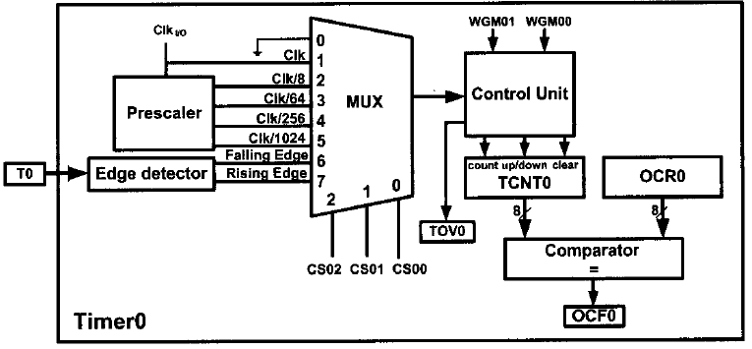
WGM01:WGM00
Timer0 can work in four different modes: Normal, phase correct PWM, CTC, and Fast PWM. The WGM01 and WGMOO bits are used to choose one of them. We will discuss the PWM options in Chapter 16.

Slide 8
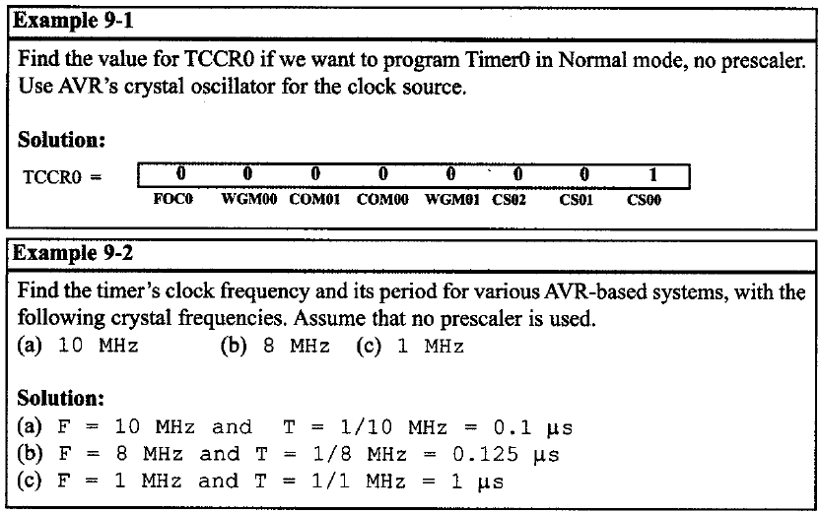
Timer0 Programming

Slide 9
TIFR (Timer/counter Interrupt Flag Register)
Bit |  | D7 |  | D6 |  |  | D5 |  | D4 |  | D3 | D2 | D1 | D0
 |  | OCF2 |  | TOV2 |  |  | ICF1 |  | OCF1A |  | OCF1B | TOV1 | OCF0 | TOV0
Read/Write |  | RW |  | RW |  |  | RW |  | RW |  | RW | RW | RW | RW
Initial value |  | 0 |  | 0 |  |  | 0 |  | 0 |  | 0 | 0 | 0 | 0
 | TOV0 |  | D0 |  | Timer0 Overflow Flag bit
 |  |  | 0 = |  | Timer0 did not overflow
 |  |  | 1 = |  | Timer 0 has overflowed (going from 0xFF to 0x00)
 | OCF0 |  | D1 |  | Timer0 Output Compare flag bit
 |  |  | 0 = |  | Compare match did not occur
 |  |  | 1 = |  | Compare match occurred
 | TOV1 |  | D2 |  | Timer1 Overflow Flag bit
 | OCF1B |  | D3 |  | Timer1 Output Compare B match flag
 | OCF1A |  | D4 |  | Timer1 Output Compare A match flag
 | ICF1 |  | D5 |  | Input Capture Flag
 | TOV2 |  | D6 |  | Timer2 Overflow Flag
 | OCF2 |  | D7 |  | Timer2 Output Compare match flag
Figure 9-6: TIFR (Timer / Counter Interrupt Flag) Register
The TIFR contains the flags of different timers.

Slide 10
Timer0 Programming
TOV0 (Timer0 Overflow)
The flag is set when the timer rolls over from FF to 00. The TOV0 flag is set to 1 and it remains set until the software clears it.
The strange thing about this flag is that in order to clear it we need to write 1 to it.
Indeed this rule applies to all flags of the AVR chip. In AVR, when we want to clear a given flag of a register we write 1 to it and 0 to the other bits.
Normal mode
In this mode, the content of the timer/counter increments with each clock. It counts up until it reaches its max of FF. When it rolls over from FF to 00, it sets high a flag bit called TOV0 (Timer Overflow).

Slide 11
Steps to program Timer0 in Normal mode
Load the TCNT0 register with the initial count value.
Load the value into the TCCR0 register, indicating which mode (8-bit or 16-bit) is to be used and the prescaler option. When you select the clock source, the timer/counter starts to count, and each tick causes the content of the timer/counter to increment by 1.
Keep monitoring the timer overflow flag (TOVO) to see if it is raised. Get out of the loop when TOVO becomes high.
Stop the timer by disconnecting the clock source, using the following instructions:
Clear the TOVO flag for the next round.
Go back to Step 1 to load TCNT0 again.

Slide 12
Timer0 Programming
// toggle bits of PORTB continuously with some delay.
#include <avr/io.h>
void T0Delay ();
int main (){
DDRB = 0xFF; // PORTB output port
PORTB = 0x55;
while(1){ //repeat forever
PORTB = ~PORTB;
T0Delay(); //delay size unknown
}
}
void T0Delay(){
TCNT0 = 0x20; // load TCNT0 (RUN AGAIN FOR TCCR0=2)
TCCR0 = 0x01; // Run Timer0, Normal mode, no prescaler
while ((TIFR & 0x01)==0); // wait for TF0 to roll over
TCCR0 = 0; // Stop Timer
TIFR = 1; //clear TF0
}

Slide 13
Timer0 Programming
Calculating Delay Length of Previous Program Assume XTAL = 8 MHz.
Sol: XTAL = 8MHz ► Clock Period = 1/8 MHz
= 0.125 µs
Timer Counts = (1+0xFF- 0x20) = 0xE0 = 224
Delay = 224 × 0.125 µs = 28 µs
Note: There will also be an Overhead Due to Instructions

Slide 14
Timer0 Programming

Slide 15
Timer0 Programming
Calculating Delay Length Using Timers
Q Write a C program to toggle only the PORTB.4 bit continuously every 70 µs. Use TimerO, Normal mode, and 1:8 prescaler to create the delay. Assume XTAL = 8 MHz.
Solution:
XTAL = 8MHz ► T_{machine Cycle} = 1/8 MHz
Prescaler = 1:8 ► T_{Clock} = 8×1/8MHz = 1µs
70µs/1µs = 70 clocks
► (1 + 0xFF) – 70
= 256 - 70 = 186 = 0xBA = -70

Slide 16
Timer0 Programming
// toggle bits of PORTB continuously with some delay.
#include <avr/io.h>
void T0Delay ();
int main (){
DDRB(C) = 0xFF; // PORTB output port
while(1){ //repeat forever
PORTB(C) = 0x55(00);
T0Delay(); //delay size unknown
PORTB(C) = 0xAA(FF);
T0Delay();
}
}
void T0Delay(){
TCNT0 = -70; // load TCNT0
TCCR0 = 0x02; // Run Timer0, Normal mode,1:8 prescaler
while ((TIFR & 0x01)==0); // wait for TF0 to roll over
TCCR0 = 0; // Stop Timer
TIFR = 1; //clear TF0
}

Slide 17
Timer0 Programming

Slide 19
Example 9-21
Assuming XTAL = 8 MHz, write a program to generate a delay of 1ms.
Solution:
Prescaler | Timer Clock | Timer Period | Timer Value
none | 8 MHz | 1/8MHz = 0.125 µs | 1ms / 0.125 µs = 8000
64 | 8 MHz / 64 = 125KHz | 1/125KHz = 8 µs | 1ms / 8 µs = 125
256 | 8 MHz / 256 = 31.25KHz | 1/31.25KHz = 32 µs | 1ms / 32 µs = 31.25
1024 | 8 MHz / 1024 = 7.8125 KHz | 1/7.8125 KHz = 128 µs | 1ms / 128 µs = 7.8125
From the above calculation we can only use the options Prescaler = 64, Prescaler = 256 or Prescaler = 1024. But we should use the option Prescaler = 64 sinece we can not use a decimal point. To wait 125 clocks we should load OCR0 with 125-1 = 124

Slide 21
Timer0 Programming
// toggle bits of PORTB continuously with some delay.
#include <avr/io.h>
void T0Delay ();
int main (){
DDRB = 0xFF; // PORTB output port
while(1){ //repeat forever
PORTB = 0x55;
T0Delay(); //delay size unknown
PORTB = 0xAA;
T0Delay();
}
}
void T0Delay(){
TCNT0 = 0; // timer starts from 00
OCR0 = 124; // Output Compare Register has value 124
TCCR0 = 0x0B; // Run Timer0,(CTC)Clear Timer on Compare Match,
// 1:64 Prescaler
while ((TIFR & 0x02)==0); // wait for OCF0 to roll over
TCCR0 = 0; // Stop Timer
TIFR = 0x02; //clear TF0
} // In Theory Delay = (124+1)*8 us = 1ms (for 8MHz Clock)

Slide 23
Example 9-20
Assuming XTAL = 8 MHz, write a program to generate a delay of 25.6 ms. Use Timer0, CTC mode, with prescaler = 1024.
Solution:
Due to prescaler = 1024 each timer clock lasts 1024 × 0.125 µs = 128 µs. Thus in order to generate a delay of 25.6 ms,
we should wait 25.6 ms / 128 µs = 200 clocks.
Therefore the OCR0 register should be loaded with 200-1 = 199.
Notice that the comparator checks for equality; thus, if we load OCR0 register wuth a value smaller than TCNT0’s value, the counter will miss the compare match and will count up until it reaches the maximum value of 0xFF and rolls over. This causes a big delay and is not desirable in many cases.

Slide 25
Timer2 Programming
Timer2 is an 8-bit timer. Therefore it works the same way as Timer0. But there are two differences between Timer0 and Timer2:
Timer2 can be used as a real time counter. To do so, we should connect a crystal of 32.768 kHz to the TOSCl and TOSC2 pins of AVR and set the AS2 bit.
In Timer0, when CS02-CS00 have values 110 or 111, Timer0 counts the external events. But in Timer2, the multiplexer selects between the different scales of the clock.
In other words, the same values of the CS bits can have different meanings for Timer0 and Timer2.

Slide 26
Bit |  |  | D7 |  |  | D6 |  |  | D5 | D4 | D3 | D2 | D1 | D0
 |  |  | FOC2 |  |  | WGM20 |  |  | COM21 | COM20 | WGM21 | CS22 | CS21 | CS20
Read/Write |  |  | W |  |  | RW |  |  | RW | RW | RW | RW | RW | RW
Initial value |  |  | 0 |  |  | 0 |  |  | 0 | 0 | 0 | 0 | 0 | 0
FOC2 |  | D7 |  | Force Compare match: a write-only bit, which can be used while generating a wave. Writing 1 to it causes the wave generator to act as if a compare match had occurred.
 | WGM20 (D6) |  |  |  | WGM21 (D3) |  |  | Timer2 mode selector bits
 | 0 |  |  |  | 0 |  |  | Normal
 | 0 |  |  |  | 1 |  |  | CTC (Clear Timer on Compare Match)
 | 1 |  |  |  | 0 |  |  | PWM, phase correct
 | 1 |  |  |  | 1 |  |  | Fast PWM
 | COM21 (D5) |  |  |  | COM20 (D4) |  |  | Compare Output Mode: These bits control the waveform generator (See Chapter 15)
CS22:20 |  | D2 |  |  | D1 |  | D0 | Timer2 clock selector
 |  | 0 |  |  | 0 |  | 0 | No Clock Source (Timer / Counter Stopped)
 |  | 0 |  |  | 0 |  | 1 | Clock (No Prescaling)
 |  | 0 |  |  | 1 |  | 0 | Clock / 8
 |  | 0 |  |  | 1 |  | 1 | Clock / 32
 |  | 1 |  |  | 0 |  | 0 | Clock / 64
 |  | 1 |  |  | 0 |  | 1 | Clock / 128
 |  | 1 |  |  | 1 |  | 0 | Clock / 256
 |  | 1 |  |  | 1 |  | 1 | Clock / 1024
Figure 9-11: TCCR2 (Timer / Counter Control ) Register

Slide 27
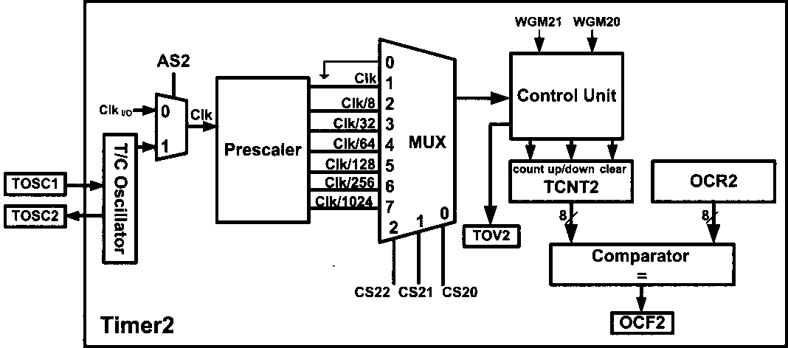
Timer2 Programming

Slide 28
Timer2 Programming

Slide 29
Timer2 Programming
#include <avr/io.h>
void T2Delay ();
int main (){
DDRB = 0xFF; // PORTB output port
while(1){ // repeat forever
PORTB = 0x55; T2Delay();
PORTB = 0xAA; T2Delay();
}
}
void T2Delay(){
TCNT2 = 0; // timer starts from 00
OCR2 = 249; // Output Compare Register has value 249
TCCR2 = 0x0E; //Run Timer2,Clear Timer on Compare Match,
// Prescaler mode 1:256
while ((TIFR & (1<<OCF2))==0); // wait for OCF2 flag
TCCR2 = 0; // Stop Timer
TIFR = (1<<OCF2); //clear OCF2 flag
}

Slide 30
Timer1 Programming
Timer1 is a 16-bit timer and it is split into two bytes, TCNT1L (Timer1 low byte) and TCNT1H (Timer1 high byte).
Timer1 has two control registers named TCCR1A (Timer/counter 1 control register) and TCCR1B.
The TOV1 (timer overflow) flag bit goes HIGH when overflow occurs.
Timer1 also has the prescaler options.
There are two 16-bit OCR registers in Timerl: OCR1A and OCR1B. There are two separate flags for each of of Timerl OCR registers, which act independently of each other.
Whenever TCNT1 equals OCR1A, the OCF1A flag will be set on the next clock. When TCNT1 equals 0CR1B, the OCF1B flag will be set on the next clock.

Slide 31
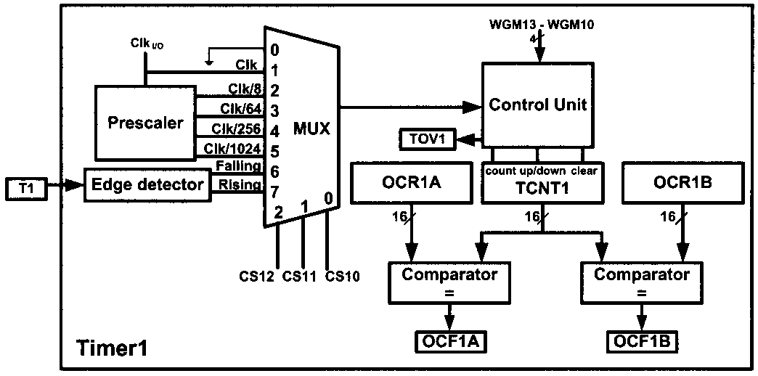
Timer1 Programming

Slide 32

Timer1 Programming
As Timer1 is a 16-bit timer, the OCR registers are 16-bit registers. OCRIA is made of OCR1AH (OCRIA high byte) and OCR1AL (OCRIA low byte).
The TIFR register contains the TOV1, OCF1A, and OCF1B flags.
There is also an auxiliary register named ICR1, which is used in operations such as capturing. ICR1 is a 16-bit register made of ICR1H and ICR1L

Slide 33
Timer1 Programming
As Timer1 is a 16-bit timer, the OCR registers are 16-bit registers. OCRIA is made of OCR1AH (OCRIA high byte) and OCR1AL (OCRIA low byte).
The TIFR register contains the TOV1, OCF1A, and OCF1B flags.

Slide 34
Timer1 Programming

Slide 37
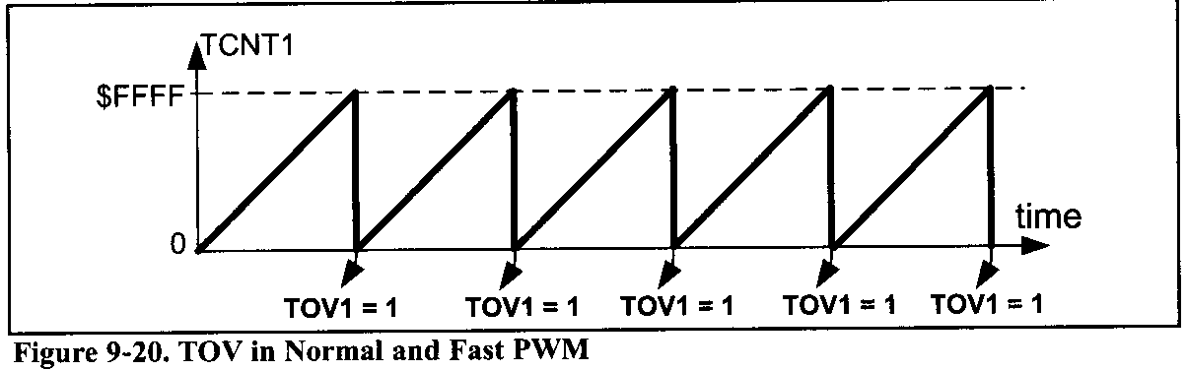
Timer1 Programming
WGM13:WGM10
The WGM13, WGM12, WGM11, and WGM10 bits define the mode of Timerl, Timerl has 16 different modes. One of them (mode 13) is reserved (not implemented). we cover mode0 (Normal mode) and mode4 (CTC mode). The other modes will be covered in Chapters 15 and 16.
Timerl operation modes
Normal mode (WGM13:10 = 0000)
In this mode, the timer counts up until it reaches 0xFFFF (which is the maximum value) and then it rolls over from 0xFFFF to 0000.
When the timer rolls over from 0xFFFF to 0000, the TOV1 flag will be set.

Slide 38
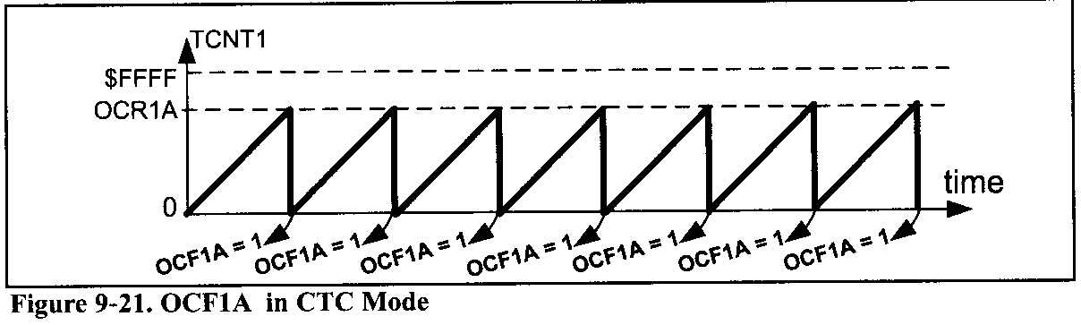
Timer1 Programming
CTC (Clear Timer on Compare Match) mode
(WGM13:10 = 0100)
In mode 4, the timer counts up until the content of the TCNT1 register becomes equal to the content of OCR1A (compare match occurs); then, the timer will be cleared when the next clock occurs. The OCF1A flag will be set as a result of the compare match as well

Slide 39
Timer1 Programming

Slide 40
Timer1 Programming

Slide 41
Timer1 Programming
#include <avr/io.h>
void T1Delay();
int main (){
DDRB = 0xFF; // PORTB output port
while(1){ // repeat forever
PORTB = 0x55; T1Delay();
PORTB = 0xAA; T1Delay();
}
return 0;
}
void T1Delay(){
TCNT1 = 0; // timer starts from 00
OCR1A = 31250 - 1; // Output Compare Register A
TCCR1A = 0x00; TCCR1B = 0x0C; //Run Timer1, Clear
// Timer on Compare Match, Prescaler mode 1:256
while ((TIFR & (1<<OCF1A))==0);//wait for OCF1A
TCCR1B = 0x00; // Stop Timer
TIFR = (1<<OCF1A); //clear OCF2 flag
}

Slide 42
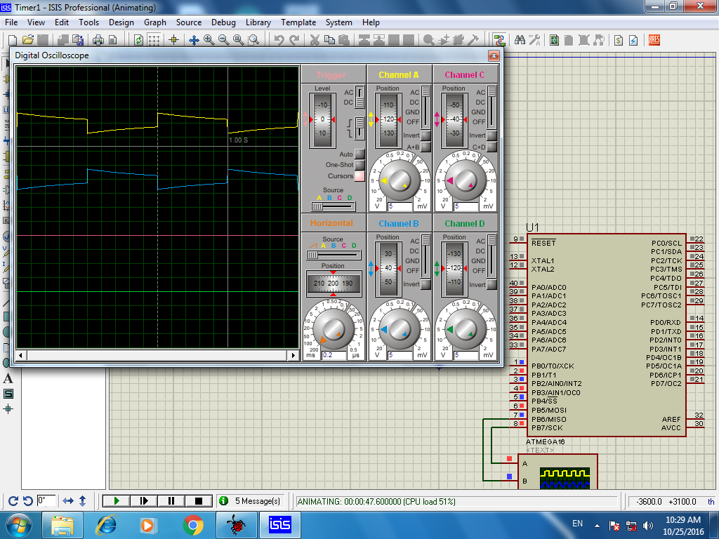
Timer1 Programming

Slide 43
Timer1 Programming

Slide 44
16-bit counter Programming
#include <avr/io.h>
int main (){
DDRB &= ~(1<<1); // Set PB.1 as input
PORTB |= (1<<1); // activate pull-up of PB.1
DDRC = 0xFF; // Set PORTC as output
DDRD = 0xFF; // Set PORTD as output
TCNT1 = 0x0000; // Set initial Count to 0
TCCR1A = 0x00; // 16-bit Normal mode
TCCR1B = 0x06; // at T1, Falling Edge Counter
while(1)
{
PORTD = TCNT1L; // Show Counter Low Byte
PORTC = TCNT1H; // Show Counter High Byte
if((TIFR & (1<<TOV1))==1) // if it overflows
TIFR = 1 << TOV1; // clear TOV1 flag
}
return 0;
}

Slide 45
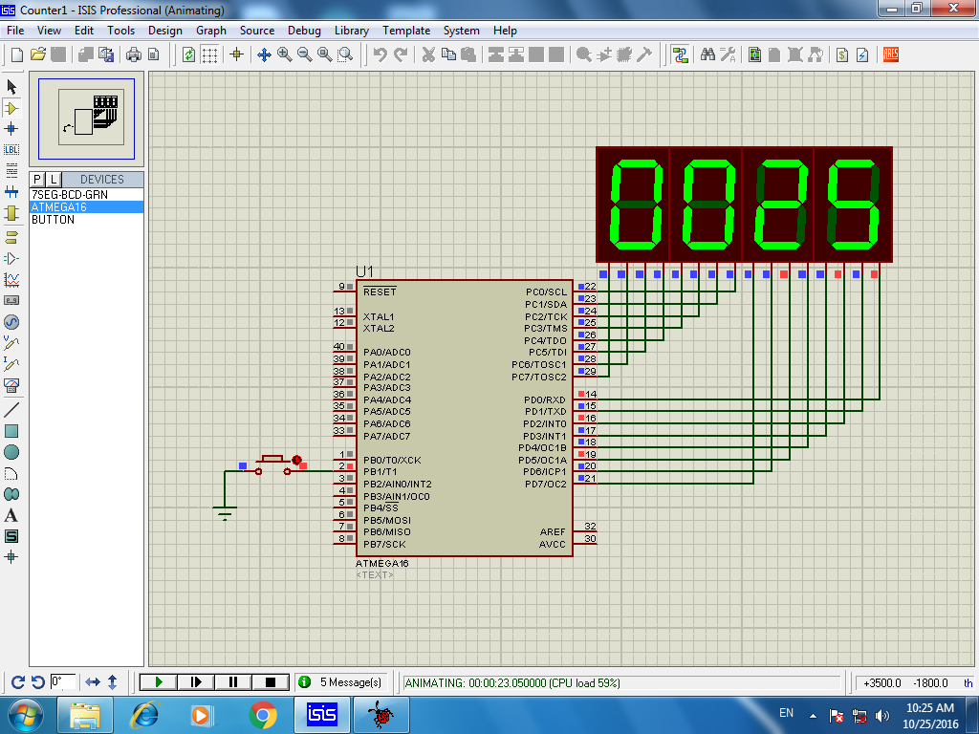
16-bit counter Programming

